Slide 1
Business Intelligence G. Mudare

Slide 2
Apriori

Slide 3
Apriori
Apriori is a seminal algorithm proposed by R. Agrawal and R. Srikant in 1994 for mining frequent itemsets for Boolean association rules.
The name of the algorithm is based on the fact that the algorithm uses prior knowledge of frequent itemset properties.
Apriori employs an iterative approach known as a level-wise search, where k-itemsets are used to explore (k+1)-itemsets.
First, the set of frequent 1-itemsets is found by scanning the database to accumulate the count for each item, and collecting those items that satisfy minimum support.
The resulting set is denoted L1.Next,
L1 is used to find L2 ,the set of frequent 2-item sets, which is used to find L3, and so on, until no more frequent k-itemsets can be found
The finding of each Lk requires one full scan of the database.

Slide 4
To improve the efficiency of the level-wise generation of frequent itemsets, an important property called the Apriori property:
Apriori property: All nonempty subsets of a frequent itemset must also be frequent.
The Apriori property is based on the following observation.
By definition, if an itemset I does not satisfy the minimum support threshold, min sup, then I is not frequent; i.e. P(I) < min sup.
If an item A is added to the itemset I, then the resulting itemset (i.e., I UA) cannot occur more frequently than I.
Therefore, I UA is not frequent either; that is, P(I UA) < min sup.
This property belongs to a special category of properties called antimonotone in the sense that if a set cannot pass a test, all of its supersets will fail the same test as well.
It is called antimonotone because the property is monotonic in the context of failing a test.

Slide 5
How is the Apriori property used in the algorithm
A two-step process is followed, consisting
join step ->To a set of candidate k-itemsets is generated by joining the set with itself.
Prune step-A scan of the database to determine the count of each candidate in the set that would result in the determination all candidates having a count no less than the minimum support count and remove such from the set.

Slide 6
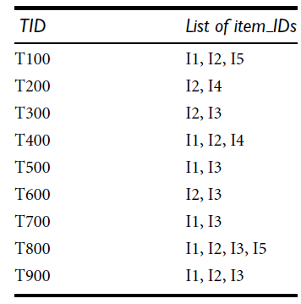
Apriori (book example)

Slide 7
Apriori by example
There are nine transactions in this database, that is, |D|= 9.
In the first iteration of the algorithm, each item is a member of the set of candidate
1-itemsets, C1.
The algorithm simply scans all of the transactions in order to count the number of occurrences of each item.

Slide 8
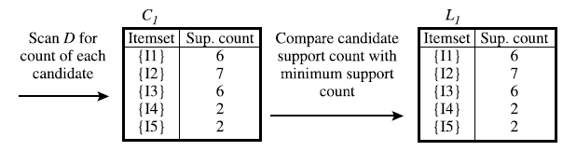
Apriori by example
Suppose that the minimum support count required is 2, that is, min_sup = 2. In our example, all of the Candidates in C1 satisfy minimum support.

Slide 9
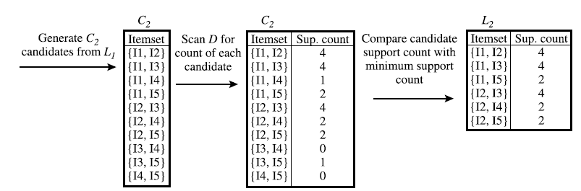
Apriori by example
To discover the set of frequent 2-itemsets, L2, the algorithm uses the join L1 on L1 to generate a candidate set of 2-itemsets
Next, the transactions in D are scanned and the support count of each candidate itemset in C2 is accumulated

Slide 10
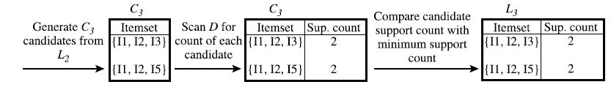
Apriori by example
determine L3

Slide 11
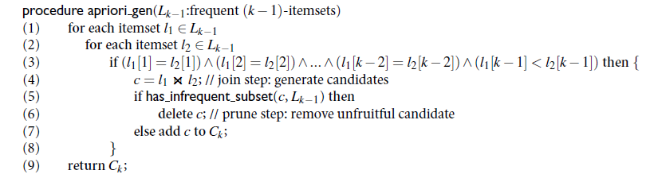
procedure apriori

Slide 12

Generating Association Rules from Frequent Itemsets
Once the frequent itemsets from transactions in a database D have been found, it is straightforward to generate strong association rules from them (where strong association rules satisfy both minimum support and minimum confidence).
Use the Equation
The conditional probability is expressed in terms of itemset support count, where support count(AUB) is the number of transactions containing the itemsets AUB, and support count(A) is the number of transactions containing the itemset A.

Slide 13
Generating association rules
For each frequent itemset l, generate all nonempty subsets of l.
For every nonempty subset s of l, output the rule (s-l )➔s)”
If
where min_conf is the minimum confidence threshold.

Slide 14
Example
Suppose the data contain the frequent itemset
l = {I1, I2, I5}.
What are the association rules that can be generated from l? The nonempty subsets of l are {I1, I2}, {I1, I5}, {I2, I5}, {I1}, {I2}, and {I5}. The resulting association rules are as shown below, each listed with its confidence:

Slide 15
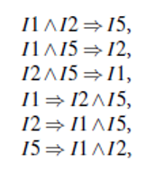
Confidence

Slide 16
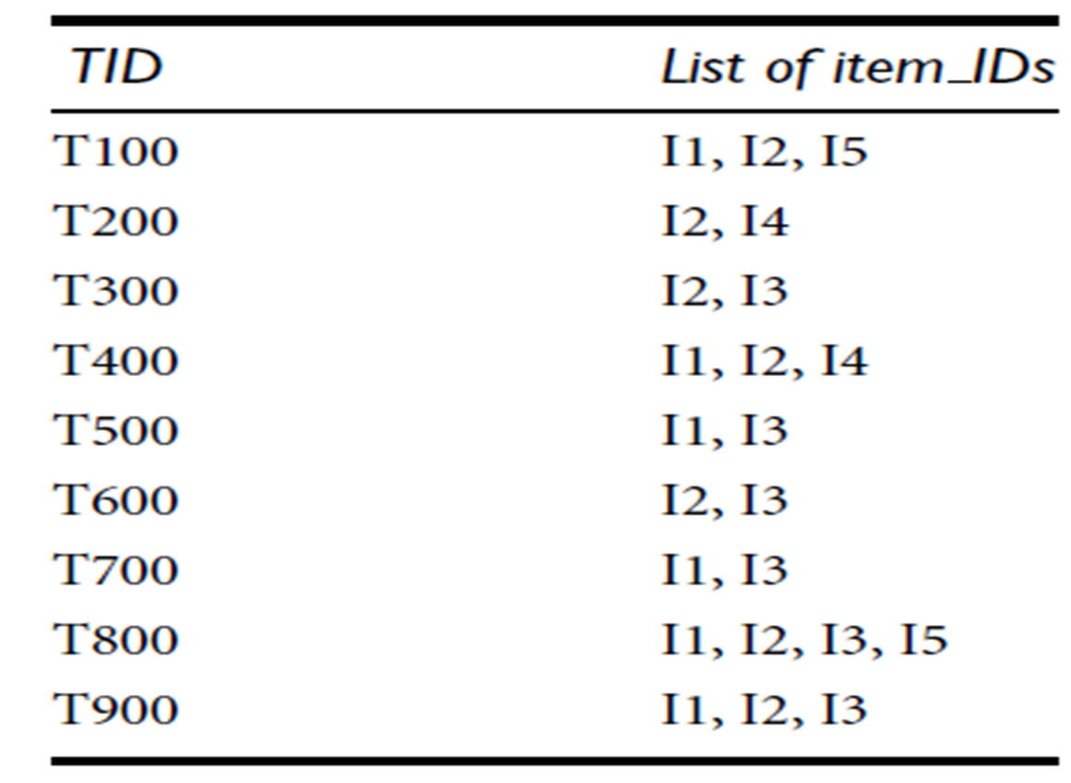
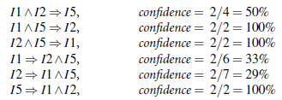
Confidence Example
If the minimum confidence threshold is, say, 70%, then only the second, third, and last rules above are output, because these are the only ones generated that are strong.

